Slide 1
Introduction to Public Key

Slide 2
Cryptology
Cryptography
Symmetric Ciphers
Asymmetric Ciphers
Cryptanalysis
Protocols
Block Ciphers
Stream Ciphers
Integer Factoring Problem
Discrete Logarithm problem
AES
DES

Slide 3
Symmetric Cryptography Revisited

Slide 4
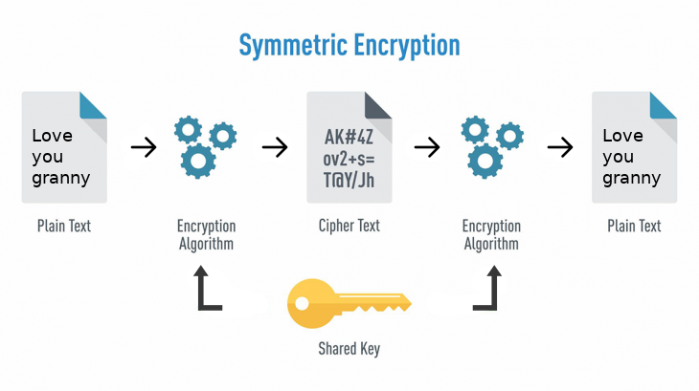
https://cdn-images-1.medium.com/max/1600/1*mnyITCNnRdeLfauh3Psmlw.png

Slide 5
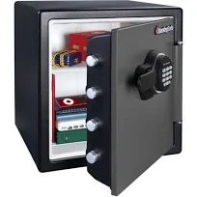



Analogy of Symmetric Cryptography
For centuries it was believed that sender and receiver need to know the same secret.

Slide 6
Problems of Symmetric Cryptography:
fast but
Number of keys: In a network, each pair of users requires an individual key
Key distribution problem: The secret key must be transported securely

Slide 7
Number of keys
https://www.cryptool.org/en/ct1-downloads

Slide 8
Key Distribution Problem
Both parties must possess a secret key which they must exchange prior to using any encryption
How?
it involved face-to-face meeting (impractical and always unsafe)
use of a trusted courier, or (impractical and always unsafe)
sending the key through an existing encryption channel. (chicken & egg problem)

Slide 9
Asymmetric cryptography
Solving the problems through asymmetric cryptography

Slide 10

Main idea of asymmetric cryptography: a key pair
Private key
Public key
Public key

Slide 11
Basic Protocol for Public-Key Encryption

Slide 12
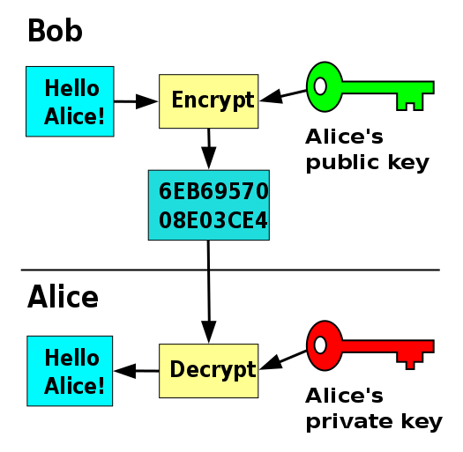

Slide 13
So do we still need symmetric cryptography?
Symmetric encryption methods have better performance

Slide 14
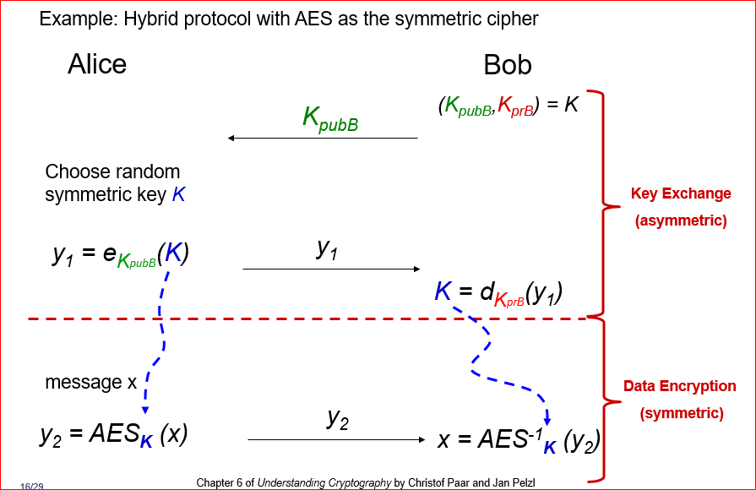
Hybrid systems

Slide 15
Essential Number Theory for Public-Key Algorithms

Slide 16
Example of public key and private key
2 . t ≡ 1 mod 5
Public key
Private key

Slide 17
Two methods to find modular inverse of 12 mod 67
12 . t ≡ 1 mod 67
t=0,1,2,3,…….66 (hard way)
Apply Extended Euclidean Algorithm (easy way)

Slide 18
Compute the greatest common divisor gcd (r0, r1) of two integers r0 and r1
gcd is easy for small numbers: 1. factor r₀ and r₁ 2. gcd = highest common factor
r₀ = 84 = 2 . 2 . 3 . 7 r₁ = 30 = 2 . 3 . 5
2 . 3 = 6 = gcd (30,84)
Factoring is complicated (and often infeasible) for large numbers

Slide 19
Compute the greatest common divisor gcd (r0, r1) of two integers r0 and r1 (easy way- Extended Euclidean Algorithm )
gcd (84, 30) = gcd (2 . 30+24, 30)
gcd (30, 24) = gcd (1 . 24+6, 24)
gcd (24, 6) = gcd (4 . 6+0, 6)
gcd (6, 0) = 6

Slide 20
Question: gcd(67,12)
gcd (67, 12) = gcd (5 . 12+7, 12) //67= 5 . 12+7
gcd (12, 7) = gcd (1 . 7+5, 7) // 12= 1 . 7+5
gcd (7, 5) = gcd (1 . 5+2, 5) // 7 = 1 . 5+ 2
gcd (5, 2) = gcd (2 . 2+1, 2) // 5 = 2 . 2+ 1
gcd (2, 1) = gcd (2 . 1+0, 1) // 2 = 2 . 1+ 0
gcd (1, 0) = 1

Slide 21
GCD(67,12): Extended Euclidean Algorithm
gcd(67,12)
67=(5)12+7
12=(1)7+5
7=(1)5+2
5=(2)2+1
2=(2)1+0 | 1=5-(2)2 1=5-(2)[7-(1)5] 1=(3)5-(2)7 1=(3)[12-(1)7]-(2)7 1=(3)12-(5)7 1=(3)12-(5)[67-(5)12] 1=(28)12-(5)*67

Slide 22
Important conclusion
We can find t 12 . t ≡ 1 mod 67 , if gcd(12, 67)=1, where t is the inverse of 12 mod 67
gcd (r₀ , r₁ ) = 1 in order for the inverse to exist, r₁ . t ≡ 1 mod r₀
(r₁ , t ) is a pair of key

Slide 23
Homework: find modular inverse of 13 mod 67
13 . t ≡ 1 mod 67
Two methods
t=0,1,2,3,…….66 (hard way)
Apply Euclidean Algorithm

Slide 24
Review Questions
Explain the key distribution problem.
What is the main motivation of the designing the asymmetric cryptography?
Discuss the differences between the symmetric and asymmetric cryptography? You can compare (1) the key choice, (2) the encryption/decryption performance, (3) the design purpose

Slide 25
Principle to design Public-Key Algorithms

Slide 26
What is the problem?
2 . t ≡ 1 mod 5
Big problem: Anyone knows the public key can find the private key!
Design goal: To design an algorithm such that we (good guy) can solve the equation (generate the private key) and other people (bad guy) are difficult to solve the equation.
Public key
Private key

Slide 27
Math behind the public key algorithm: One-way function
Computing y = f(x) is computationally easy
Computing x = f⁻¹(y) is computationally infeasible

Slide 28
Three hard math problems
Factoring integers: Given a composite integer n, find its prime factors (Multiply two primes: easy)
Discrete Logarithm: Given a, y and m, find x such that a^{x} = y mod m (Exponentiation a^{x} : easy)
Elliptic Curves

